Slide 1
Chapter 3: Hedging Strategies using Futures
A. Overview: Hedgers use futures to minimize risk.
1. What is the risk they are minimizing?
The variance of the value of the unhedged position –
how much uncertainty about the risk being taken.
2. Should you buy or sell futures to hedge your risk?
Short Hedge: if you risk losing money when
the value of the asset declines, need to sell (short) futures.
(example – Wheat Farmer – seller of wheat).
Long Hedge: if you risk losing money when
the value of the asset rises, need to buy (long) futures.
(example – Wonder Bread – buyer of wheat).

Slide 2
A. Overview of Hedging Strategies
3. Under what circumstances can risk be eliminated?
Can attain a perfect hedge (σ = 0) if:
a. If the asset you are hedging is identical
to the asset underlying the futures contract; and
b. If you wish to hedge risk until futures expiration;
c. Then have perfect correlation (ρ = 1).
4. Why hedge anyway? (+ = for hedging; - = against)
+ Risks (uncertainty) outside your control could ruin firm.
- But shareholders can manage risk themselves.
+ But firm can hedge more efficiently (cheaply, effectively).
- But shareholders can at least diversify cheaply, effectively.
+ Firm has a duty to take prudent risks (legal issues, …).
5. Other questions to be answered in this chapter:
- If perfect hedge is not possible, how much can risk be reduced?
- Which futures contract should be used to hedge?
- How many futures contracts should be bought or sold?

Slide 3
B. Basis Risk
1. Defn: Basis = S - F.
│
│ Lesson 1: σ_{F} > σ_{S}
│ Lesson 2: ρ < 1
│ Lesson 3: Basis varies
│
│
│
│_________________________________ time
^{expiration}
2. Complications for hedger that lead to Basis Risk:
a. Asset being hedged may not be the same as
Asset underlying futures contract.
b. Hedger may be uncertain about exact date
when asset must be bought / sold.
c. Hedge may require futures to be
closed out before its expiration date.
F
Basis
S

Slide 4
B. Basis Risk
We will elaborate on each complication that causes basis risk.
3. If asset being hedged is same as underlying asset:
a. Basis = 0 at expiration.
b. Basis may not = 0 prior to expiration.
For low r_{f} currencies, gold, or silver, F > S, so that Basis < 0 (contango).
For high r_{f} currencies, & other commodities, F < S, so that Basis > 0 (backwardation).
c. If Basis ↑, it “strengthens;” If Basis ↓, it “weakens.”
d. Basis Risk for investment assets < for consumption assets
i. For investment assets, arbitrage leads to clear relation between F & S.
Not so for consumption assets (only inequality).
ii. For investment assets, basis risk is due to uncertainty about the riskfree rate.
iii. For consumption asset, basis risk is also due to
(preview) imbalances between Supply and Demand, and difficulties in storage
(and thus large variations in convenience yield).

Slide 5
B. Basis Risk
4. Long Hedge for Purchase of an Asset:
(Wonder Bread wheat buyer)
Define
F₁ : Futures price at time hedge is set up (buy at F₁)
F₂ : Futures price at time asset is purchased (sell at F₂)
S₂ : Asset price at time of purchase (buy for S₂)
b₂ : Basis at time of purchase (S₂ - F₂)
Cost of asset = S₂
Gain on Futures = F₂ - F₁ (assuming F↑)
Net amount paid = S₂ - (F₂ - F₁) = F₁ + (S₂ - F₂)
= F₁ + b₂
Lock into paying F₁, but don’t know what basis (b₂) will be.

Slide 6
B. Basis Risk
5. Short Hedge for Sale of an Asset:
(wheat farmer)
Define
F₁ : Futures price at time hedge is set up (sell at F₁)
F₂ : Futures price at time asset is sold (buy at F₂)
S₂ : Asset price at time of sale (sell for S₂)
b₂ : Basis at time of sale (S₂ - F₂)
Price of asset = S₂
Gain on Futures = F₁ - F₂ (assuming F↓)
Net amount received = S₂ + (F₁ - F₂) = F₁ + (S₂ - F₂)
= F₁ + b₂
Lock into receiving F₁, but don’t know what basis (b₂) will be.

Slide 7
B. Basis Risk
Problem 3.10. keep
Does a short hedger’s position improve or worsen
when the basis strengthens (increases) unexpectedly?
A short hedger (wheat farmer) is long the asset (has wheat) and short futures.
If S↑, the long position makes money – get more for wheat (improves).
If F↓, the short position makes money – gain on futures (improves).
Basis = S - F. The basis increases when S↑ or F↓.
Therefore, a short hedger’s position improves when the basis strengthens (↑).
HOWEVER! F & S typically move in the same direction.
That’s why this is an effective hedge!
The question is whether the DIFFERENCE (S - F) will widen or narrow.
That’s what matters to the hedger.

Slide 8
B. Basis Risk
Problem 3.10, continued. Needs elaboration! keep
Example: Suppose S = $3.00 / bu and F = $3.05 / bu;
Basis = -$.05; The farmer has wheat and shorts futures.
Then suppose S↓ by $1 to $2.00 / bu. What happens to F? To Basis?
1. Suppose F↓ also by $1.00, to $2.05;
Here Basis remains at -$.05, before & after price changes.
The $1.00 lost on wheat is all gained back on futures. Basis has not changed.
The short hedger’s position has not improved or worsened – hedged effectively.
All they lost on the spot is gained back on futures.
2. Suppose F↓ by less than $1.00, to $2.07; (F ↓ by $.98)
Here the Basis↓ (becomes a bigger negative number – weakens) to -$.07;
The $1.00 lost on wheat is not all gained back on futures ($.98).
Basis has decreased, the short hedger’s position has worsened slightly.
3. Suppose F↓ by more than $1.00, to $2.03; (F ↓ by $1.02)
Here the Basis↑ (becomes a smaller negative number – strengthens) to $-.03;
The $1.00 lost on wheat is more than gained back on futures ($1.02).
Basis has increased, the short hedger’s position has improved slightly.

Slide 9
B. Basis Risk
If asset being hedged is not same as underlying asset.
(For example, hedging spot price of jet fuel with heating oil futures.)
a. Cross-Hedge: Basis may not = 0 at expiration.
b. Basis risk is usually greater.
There is another component of basis risk. (No futures for jet fuel.)
Before, Basis = S - F. (e.g., S for jet fuel - F for jet fuel)
Now, Let S = spot price of asset being hedged (jet fuel);
S* = spot price of asset underlying F (heating oil);
Now there is clear relation between S* & F (both heating oil) rather than between S & F (jet fuel & oil).
Add and subtract S*, and rearrange terms:
Basis = (S* - F) + (S - S*); has another component.

Slide 10
B. Basis Risk
7. For Cross-Hedge, choice of contract has 2 components:
a. Choice of asset underlying the futures contract.
i. If asset being hedged is same as that for futures, choice is easy.
ii. Otherwise, pick F (and S*) most closely correlated with S.
b. Choice of delivery month.
i. May choose delivery month same as hedge expiration,
or may choose later delivery month.
** ii. Usually choose next delivery month after hedge expiration:
- F is often erratic during expiration month (more Basis risk).
- long hedger runs risk of having to take delivery.
- Basis risk increases as time between
hedge expiration and delivery month increases.
iii. This choice depends on liquidity of contracts with different maturities.
- In practice, nearby contract is most liquid (low TC).
- Hedger may choose short maturity futures, and roll them forward.

Slide 11
C. Minimum Variance Hedge Ratio
Consider Cross-Hedge - if the assets are different.
Deriving the Minimum Variance Hedge Ratio (h*).
1. Given that Basis may not = 0 at expiration,
want to know its possible outcomes.
a. What is mean and variance of Basis?
Now “hedging” means managing the tails of this distribution.
2. Definition: Hedge Ratio (h).
Let N_{A} = # of units of asset held (the risk exposure);
N_{F} = # of units of (similar) asset hedged with futures.
a. h = N_{F} / N_{A} = (size of futures position) ÷ (size of exposure).
b. Up to now, have assumed h = 1 [amt hedged = amt exposed].

Slide 12
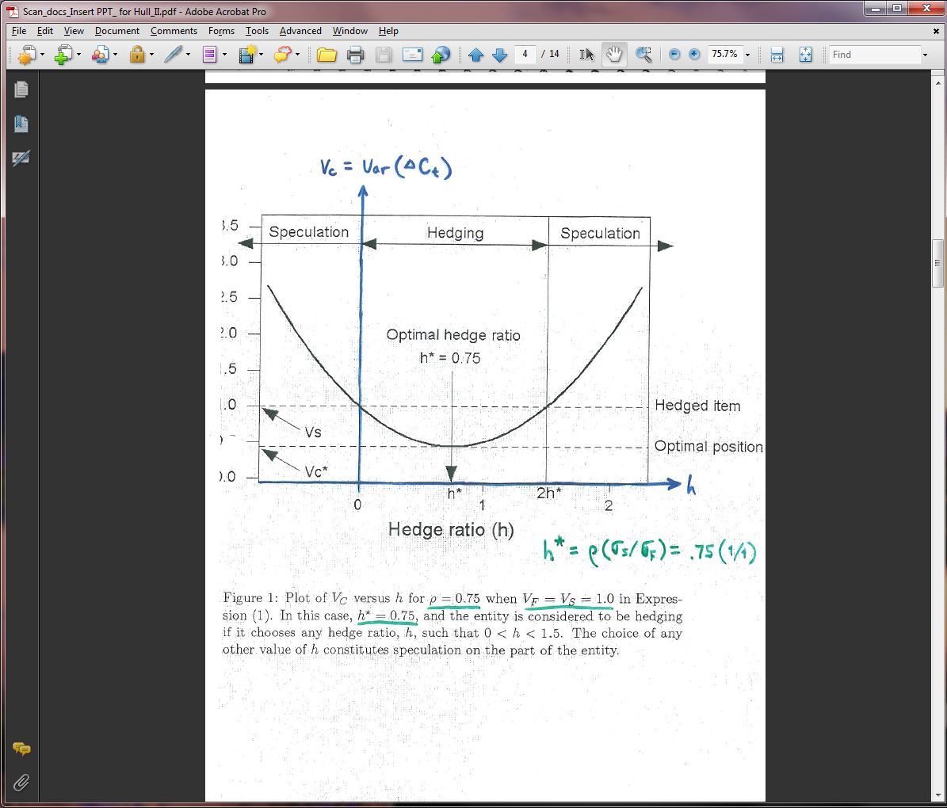
C. Minimum Variance Hedge Ratio
3. As we vary h, the variance of hedger's position varies.
a. h* = value of h that minimizes the variance of hedger's position.
b. If objective is to minimize risk, h* may not = 1!

Slide 13
C. Minimum Variance Hedge Ratio
4. The Framework. Consider a short hedge ( long S_{t} , short h x F_{t} ).
Focus on combined hedged position in asset and futures.
Derive minimum variance hedge ratio (h*).
a. Notation: S_{t} = Spot price of asset at time t (t = 1, 2).
F_{t} = Futures price at time t.
ΔS = Change in S during period of hedge (S₂ - S₁).
ΔF = Change in F " " " " (F₂ - F₁).
σ_{S} = Standard deviation of ΔS.
σ_{F} = Standard deviation of ΔF.
ρ = Correlation between ΔS and ΔF.
b. Definitions: C_{t} = S_{t} - h F_{t} = combined hedged position;
[Long the asset (S_{t}) and short h futures (F_{t}), where h = hedge ratio.]
Note: ΔC_{t} = ΔS_{t} - h ΔF_{t} ,
and: h* = ρ(σ_{S} / σ_{F}) = optimal hedge ratio → min Var(ΔC_{t}).

Slide 14
C. Minimum Variance Hedge Ratio
c. Derivation of formula for h*:
Want to minimize uncertainty about combined hedged position;
Want to minimize V_{C} = Var(ΔC_{t}) = Var [ ΔS - h ΔF ].
// \\
Digression: Var [ aX + bY ] = a² σ_{X}² + b² σ_{Y}² + 2ab(ρ σ_{X} σ_{Y}).
\\ //
Var [ ΔS - h ΔF ] = σ_{S}² + h²σ_{F}² - 2h(ρ σ_{S} σ_{F}) ---(parabola in h)
∂Var [ ΔS - h ΔF ] / ∂h = 2(h*)σ_{F}² - 2(ρ σ_{S} σ_{F}) = 0
Solving for h*: h* = (ρ σ_{S} σ_{F}) / σ_{F}²
╔═══════════╗
or: ║ h* = ρ(σ_{S} / σ_{F}) ║
╚═══════════╝

Slide 15
C. Minimum Variance Hedge Ratio
╔════════════════════════╗
5. Intuition: ║ h* = ρ(σ_{S} / σ_{F}) = optimal (N_{F} / N_{A}) ║
╚════════════════════════╝
Or, Optimal N_{F} = N_{F}* = (h*) N_{A} .
Note: If F changes 1%, expect S to change h*%;
If S changes 1%, expect F to change (1 / h*)%.
a. If ρ = 1 and σ_{F} = σ_{S}, then h* = 1;
F and S mirror each other perfectly.
If S changes 1%, expect F to change 1%;
Perfect hedge; N_{F}* = (1) N_{A} --- hold same amount of F as S.
b. If ρ = 1 and σ_{F} = 2σ_{S}, then h* = 1/2; ( Recall lesson 1: σ_{F} > σ_{S} )
F always changes by twice as much as S.
If S changes 1%, expect F to change 2%;
Perfect hedge; N_{F}* = (1/2) N_{A} --- hold half as much of F as S.

Slide 16
C. Minimum Variance Hedge Ratio
╔═══════════╗
║ h* = ρ(σ_{S} / σ_{F}) ║
╚═══════════╝
c. If ρ < 1, then h* depends on magnitude of ρ and ratio, σ_{S} / σ_{F}.
Intuition still holds true.
If S changes 1%, expect F to change (1 / h*)%;
Imperfect hedge; N_{F}* = h*N_{A} --- hold h* as much F as S.
d. Example: If h* = .786, futures position should have
78.6% of face value of asset being hedged.
If S changes 1%, expect F to change more (1 / .786)%;
Imperfect hedge; if you hold N_{F}* = (.786) N_{A},
the value of your futures position is
expected to just offset the change in S.

Slide 17
C. Minimum Variance Hedge Ratio
╔═══════════╗
║ h* = ρ(σ_{S} / σ_{F}) ║
╚═══════════╝
e. To minimize risk, should the hedger hold more or less futures,
compared to the amount held of the underlying risk exposure?
Is h* > 1 or < 1?
Lesson 1: σ_{F} > σ_{S}
Lesson 2: ρ < 1
This means: h* = ρ(σ_{S} / σ_{F}) < 1 for most situations.

Slide 18
C. Minimum Variance Hedge Ratio
f. h* is slope of best fit line when ΔS is regressed on ΔF.
In practice, get data on ΔS & ΔF, measured over hedge horizon.
Regression coefficient is hedge ratio, h*.
ΔS
│ ● ●
│ ● ●
│ ●
│● ● ●
● │
│ ● ● ● ●
● ● │ ● ●
● │ ● ●
──────────────────────────────────────────────── ΔF
● ● ● ● │
● ● ● │ ●
● ● │● Lesson 1: σ_{F} > σ_{S}
● │ Lesson 2: ρ < 1
● ● ● │
● ● │ Slope = h* = ρ(σ_{S} / σ_{F}) < 1
● │
│

Slide 19
C. Minimum Variance Hedge Ratio
6. Hedge effectiveness: ρ² or h*² [ σ_{F} / σ_{S} ]².
a. The R² in this simple regression.
b. Proportion of Var [ ΔS ] explained by movemts in ΔF:
c. Proportion of Var [ ΔS - hΔF ] eliminated by hedging.
FAS 133 requires hedgers to show they expect hedge to be
“highly effective.” R² of regression! See papers on FAS133;
Kawaller & Koch, Journal of Derivatives, 2000;
Charnes, Berkman & Koch, Journal of Applied Corporate Finance, 2003;
Juhl, Kawaller, & Koch, Journal of Futures Markets, 2012;
Kawaller & Koch, Journal of Derivatives, 2013.

Slide 20
C. Minimum Variance Hedge Ratio
7. Optimal number of futures contracts (N*).
a. Define: N_{A} = size of position being hedged (units);
Q_{F} = size of one futures contract (units).
Recall, h* = N_{F}* / N_{A}; or, N_{F}* = (h*) N_{A}.
The futures hedge should have a face value of (h*) N_{A}.
Thus, get N* by simply dividing this face value (N_{F}*) by Q_{F}:
╔════════════════════════════╗
║ N* = [ (h*) N_{A} ] / Q_{F} = [ (ρσ_{S} / σ_{F}) N_{A} ] / Q_{F} ║
╚════════════════════════════╝
b. In practice, # of futures contracts must be an integer;
Thus, hedger can only approximate optimal hedge.

Slide 21
C. Minimum Variance Hedge Ratio
8. Tailing the Hedge:
a. When futures used for hedging, small adjustment can be made
to account for the impact of daily settlement (tailing the hedge).
b. Old equation: N* = [ (h*) N_{A} ] / Q_{F}
c. New Equation: N** = [ (h*) V_{A} ] / V_{F} = [ (h*) N_{A} ] / Q_{F} * (S / F)
where V_{A} = $ value of position being hedged (V_{A} = (S) N_{A} );
V_{F} = $ value of one futures contract (V_{F} = (F) Q_{F} ).
d. Effect of tailing the hedge is to multiply the hedge ratio (h*)
by the ratio of spot price to futures price, or (S / F).
e. If contango (F > S), then (S / F) < 1, & tailing the hedge ↓ N**.
If backward. (F < S), then (S / F) > 1, & tailing the hedge ↑ N**.
f. If forwards used, no daily settlement, no need to tail the hedge.

Slide 22
C. Minimum Variance Hedge Ratio
9. Example: Cross-Hedge; (no daily settlemt; no tailing)
Airline uses Heating Oil forwards to hedge Jet Fuel costs.
Airline will purchase 2 million gallons of Jet Fuel in 1 month, and hedges by buying xxxx gallons of Heating Oil forward.
From historical data σ_{F} = 0.0313, σ_{S} = 0.0263, & ρ = 0.928
Airline should buy forward
(.7777) x (2,000,000 gal)
= 1,555,400 gal (fwd 1 mo).
Or, if they use Heating Oil futures: 1 contract = 42,000 gal.
N* = [ (h*) N_{A} ] / Q_{F} = [ (.7777) x (2,000,000 gal )] / (42,000 gal)
= 37.03 contracts.
The Airline would buy 37 futures contracts (if no tailing).

Slide 23
C. Minimum Variance Hedge Ratio
10. Example: Cross-Hedge; (daily settlemt; tailing hedge)
If Airline uses Heating Oil futures to hedge Jet Fuel costs.
From historical data σ_{F} = 0.0313, σ_{S} = 0.0263, & ρ = 0.928
The size of one Heating Oil contract is 42,000 gal.
Spot price = S = $1.94 / gal; Futures price = F = $1.99 / gal.
Optimal number of contracts after tailing the hedge:
N** = [ (h*) V_{A} ] / V_{F} = [ (h*) N_{A} ] / Q_{F} x (S / F)
= [ (.7777) x ($1.94 x 2,000,000 gal ) ] / ($1.99 x 42,000 gal )
= 36.10 contracts. (Note: S < F, (S / F) < 1; N** ↓)
The Airline should buy 36 contracts.

Slide 24
D. Hedging a Stock Portfolio
Hedging stock portfolio with Stock Index Futures.
1. Define: V_{A} = Current value of stock portfolio;
V_{F} = Current value of one futures contract.
2. If stock portfolio perfectly matches the index (β = 1),
Optimal Number of Futures Contracts = N* = V_{A} / V_{F}.
a. Example: V_{A} = $1,000,000;
Index Value = 1,000;
V_{F} = $250 x Index = $250,000;
Short N* = V_{A} / V_{F} = $1,000,000 / $250,000 = 4 contracts.
( Value of 4 contracts matches Value of stock portfolio. )

Slide 25
D. Hedging a Stock Portfolio
3. If stock portfolio does not perfectly match index (β ≠ 1),
Need to consider Beta of portfolio, β_{pm}.
a. Appeal to CAPM: k_{p} = r + [ E(R_{m}) - r ] β_{pm} .
Now Optimal Number of Contracts = N* = β_{pm} (V_{A} / V_{F}).
b. Steps for hedging:
i. Estimate β_{pm} .
ii. Compute optimal number of futures contracts:
╔════════════════╗
║ N* = β_{pm} (V_{A} / V_{F}) ║
╚════════════════╝
iii. Short N* futures contracts.
c. Example: V_{A} = $1,000,000; β_{pm} = .75;
Index Value = 1,000; V_{F} = $250 x Index = $250,000;
Short N* = β_{pm} (V_{A} / V_{F}) = .75 (4) = 3 contracts.

Slide 26
D. Hedging a Stock Portfolio
d. This optimal hedge (N*) reduces market beta to zero
[ for the hedged portfolio (stock portfolio + futures) ].
In the example, if market ↓ 10.0%,
Expect portfolio to ↓ 7.5% = β_{pm} (10%);
Short position in 3 contracts will increase 7.5%.
Thus, the total value of hedged position
should be roughly independent of index value;
Expect to earn riskfree rate over life of hedge.
e. This hedging strategy assumes:
i. Dividend yield on index is predictable;
ii. Riskfree rate is constant during life of hedge;
iii. Portfolio has a stable β_{pm} during life of hedge.
iv. Portfolio is diversified (only systematic risk).
If assumptions not true, hedge less effective.

Slide 27
D. Hedging a Stock Portfolio
4. Two reasons for hedging with stock index futures.
(Why hedge so you can expect to earn riskfree rate?)
a. α Fund:
If you can consistently pick undervalued stocks (that beat mkt),
this hedge removes the market risk;
Hedged portfolio should perform > r,
to the extent that your picks outperform the market.
b. May like stock portfolio long term,
but worried about short term.
Need short term protection; Use futures for timing.
[If you sold entire portfolio, & later bought back, high TC!]

Slide 28
D. Hedging a Stock Portfolio
5. Can change beta of portfolio to anything desired.
a. N* = β_{pm} (V_{A} / V_{F}) contracts reduce β from β_{pm} to zero.
b. N* / 2 contracts reduce β from β_{pm} to β_{pm} / 2.
c. In general, can change β from β_{pm} to any β* desired:
i. If β_{pm} > β*, short (β_{pm} - β*) (V_{A} / V_{F}) contracts;
ii. If β_{pm} < β*, long (β* - β_{pm}) (V_{A} / V_{F}) contracts.
6. Can use stock index futures to hedge individual stock.
a. Special case of 5. above, where β_{pm} = β_{im}.
N* = β_{pm} (V_{A} / V_{F}) contracts reduce β of stock from β_{im} to 0.
b. Note: N* is calculated same way, but performance worse!
This hedge only protects against systematic (market) risk,
not unsystematic risk in individual stock. (See Prob. 3.18)

Slide 29
E. Stack and Roll
1. Expiration date of the hedge may be later than
delivery dates of all usable (liquid) futures contracts.
User chooses short term (nearby) futures contract to hedge until it expires;
Then rolls hedge forward; as futures expire, close one & open another.
Procedure: company expects to receive price in future at time Tn;
T0: Short futures contract #1 expiring at T1;
T1: Close out futures contract #1;
Short futures contract #2 expiring at T2;
T2: Close out futures contract #2;
Short futures contract #3 expiring at T3; . . .
Tn-1: Close out futures contract #n-1;
Short futures contract #n expiring at Tn;
Tn: Close out futures contract #n.
Will not be perfect hedge. Outcome depends on futures prices you’ll get
at times T1, T2, …, Tn. If market moves against, margin calls can hurt!

Slide 30
E. Stack and Roll
2. Metallgesellschaft Case (MG).
MG sold huge volume of 10-year forward heating oil contracts.
Customers paid 6-7 cents above market price;
Locked into heating oil prices for 5-10 years.
Then MG hedged risk that oil prices would rise over next 10 years,
by buying short term futures; and rolling them over each month.
Problem: Prices dropped; huge margin calls on long futures.
No Problem?
Short term outflows should be offset by long term inflows (in 10 yr!).
Problem? Short term outflows were huge!
MG decided to bail out – unwound hedges; Lost $1.3 Billion.

